Slide 1

CS6811-PROJECT WORK Automatic Number Plate Recognition System using EasyOCR
Date : 09.08.2021
PRESENTED BY
Aditya Antony Lambert(311018104003)
Amalraj P(311018104007)
Charan A R(311018104016)
Gowtham J K(311018104023)
Ram Kumar P(3110181040304)
TEAM NO : 10
SUPERVISOR
Mr. S BAIRAVEL
Assistant Professor-SG
(CSE)

Slide 2
ABSTRACT
Automatic number-plate recognition is a technology that uses optical character recognition on images to read vehicle registration plates.
Automatic number-plate recognition can be used to store the images captured by the cameras as well as the text from the license plate.
An automated, fast, accurate and robust vehicle plate recognition system has become need for traffic control and law enforcement of traffic regulations; and the solution is anpr (automatic number-plate recognition).

Slide 3
INTRODUCTION
Automatic Number-Plate Recognition systems compromises integration of Artificial Intelligence along with computer vision and pattern recognition.
Optical character recognition (EasyOCR) plays a chief role in automatic number plate recognition.
In Automatic number-plate recognition, we extract the license number i.e., the characters from a given image of a vehicle by using various dependencies and python programming.

Slide 4
Automatic Number-Plate Recognition system is used for many purposes like toll way authorities uses this system for allowing the vehicle to enter the toll road by detecting their number plate automatically and use it for useful purpose.
In most cases, vehicles are identified by their license plate numbers, which are easily readable by humans but not machines.
So, by using Optical Character Recognition (OCR) we can easily identify the characters of the number plate to be recognized.
The foremost function of our project is to recognize the characters of a given number plate by using the EasyOCR.

Slide 5
WHAT IS EASY-OCR?
EasyOCR is a python package that allows the image to be converted to text.
EasyOCR is built with Python and Pytorch deep learning library.
The detection part is using the CRAFT algorithm and the Recognition model is CRNN.
It is composed of 3 main components, feature extraction (we are currently using Resnet), sequence labelling (LSTM) and decoding (CTC).
EasyOCR doesn’t have much software dependencies, it can directly be used with its API.

Slide 6
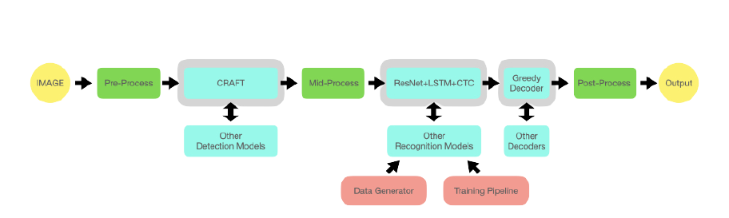
EasyOCR Process

Slide 7
The existing ANPR system
High quality imaging –the quality of the captured image is high, so that it will be easy to evaluate the attributes of the image.
Minimal skewing and rotation –the camera is fit such that the captured image or video will not suffer much decent angle of skewing and rotation.
Risk of mismanagement and of data when the project is in development.
Moreover, cameras deployed in India tend to be of lower quality, thereby compounding the ability for ANPR engines to accurately decode the license plate.

Slide 8
The Proposed ANPR system
Our Proposal which helps in achieving a higher accuracy ANPR system with Plate Recognizer is a 3-stage technique.
Three Main Stages Are:
Number Plate Localization (NPL)
Character segmentation
OCR matching

Slide 9
Number Plate Localization (NPL) :
Number Plate (NPs) are identified and localized in the scene and improve plate visual using pre-processing techniques.
Character segmentation :
Characters are segmented from the detected Number-Plate so only useful information is retained for recognition.
OCR matching :
OCR transforms character into encoded text information.

Slide 10
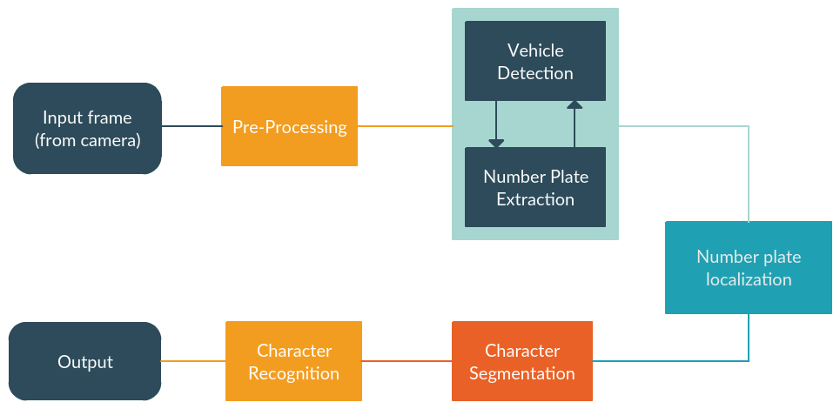
System Architecture

Slide 11
Pre-Processing
In The pre-processing phase, there is a series of operations performed on the scanned input image.
It enhances the image rendering it suitable for segmentation the Gray-level character image is normalized into a window sized.
After noise reduction, we produced a bitmap image.
Then, the bitmap image was transformed into a thinned image.

Slide 12
Segmentation
In the segmentation of number plate characters, numberplate is segmented into its constituent parts obtaining the characters individually.
Image is filtered for enhancing the image and removing the noises and unwanted spots.
Then dilation operation is applied to the image for separating the characters from each other if the characters are close to each other.
Each character is then resized and stored in row matrix respectively.
This dataset is used as the input of the trained neural network for testing either the characters matched or not.

Slide 13
Region Extraction
Plate region extraction is the first stage in this algorithm.
Image captured from the camera is first converted to the binary image consisting of only 1’s and 0’s (only black and white) by thresholding the pixel values of 0 (black) for all pixels in the input image with luminance less than threshold value and 1 (white) for all other pixels.
Thus, converting color image to Black-Grey color for better extraction.

Slide 14
Character Recognition Using EasyOCR
After the segmentation process the last step is the character recognition.
For this step the output of the segmentation process is used as the input.
Means the segmented characters’ output matrix is feed to the neural network and neural network make some processing on it and give the results as text.

Slide 15
Stages in System Implementation
COLLECTING DATASET . For training the model we need datasets of vehicles with number plate in it. These datasets must consist all kinds of images of vehicle with good lighting, poor lighting, good quality image and bad ones. This helps the model to be pre-trained well.
PRE PROCESSING. The data preparation stage is when data is profiled, formatted and structured as needed to make it ready for training the model .Pre-processing is an improvement of the image data that suppresses unwilling distortions or enhances some image features important for further processing, although geometric transformations of images

Slide 16
TRAINING MODEL. A training model is a dataset that is used to train an algorithm. The training model is used to run the input data through the algorithm to correlate the processed output against the sample output.
TESTING MODEL. By testing the model we can know that the model has trained well for its application and if not, let the model train for extra times more than before

Slide 17
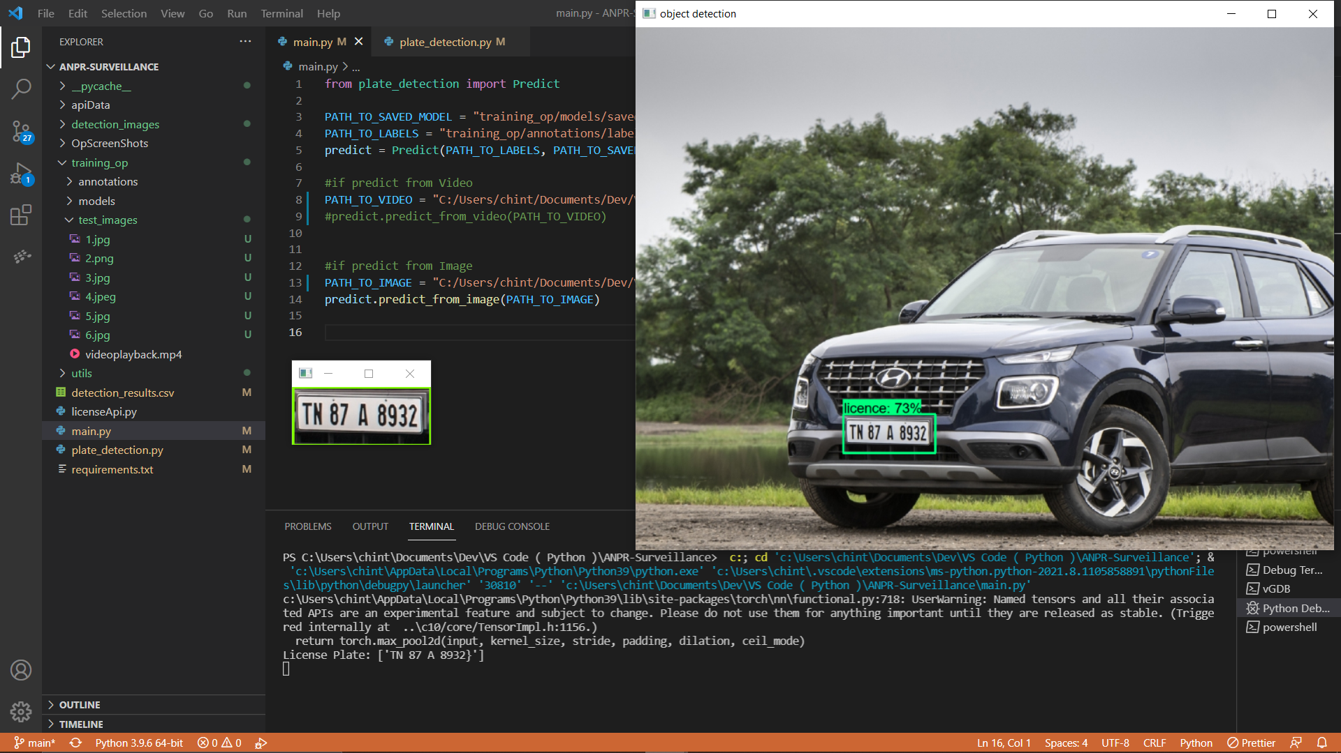
SNAPSHOTS

Slide 18
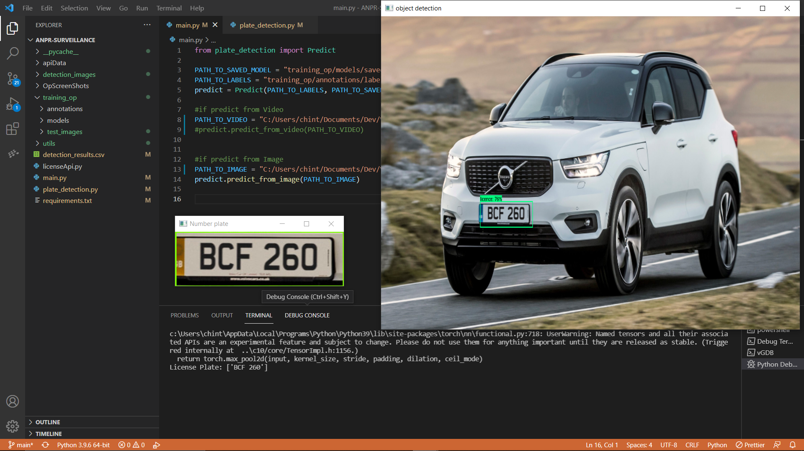

Slide 19
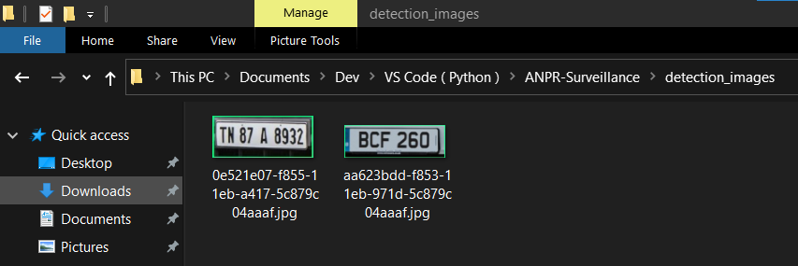
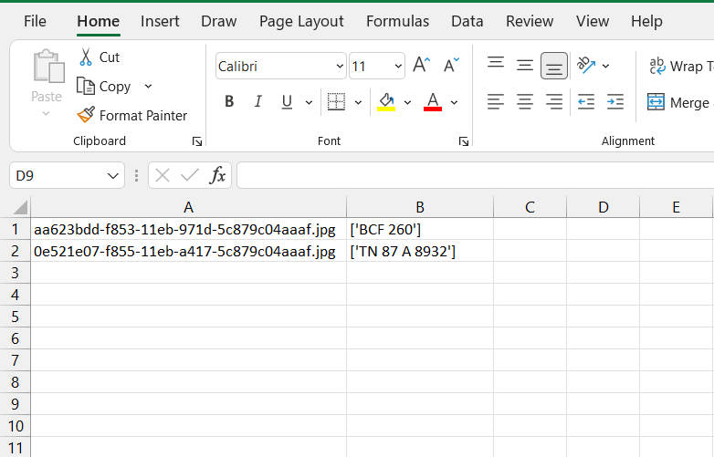

Slide 20
CONCLUSION
In this paper, the Automatic Number Plate Recognition system using EasyOCR is presented. And by performing this model, we are able to achieve an average of 89% accuracy. This system uses image processing techniques for recognition of the vehicle from the database stored in the computer.
The system works satisfactorily for wide variation of conditions and different types of number plates. The system is implemented and executed in Visual Studio code and performance is tested on genuine images. This ANPR system works quite well however, there is still room for improvement.

Slide 21
This ANPR system speed can be increase with high resolution Images and Cameras. which can be able to capture clear images of the vehicle. The OCR method is sensitive to misalignment and to different sizes, so we have to create different kind of templates for different RTO specifications.
The statistical analysis can also be used to define the probability of detection and recognition of the vehicle number plate.
At present there are certain limits on parameters like speed of the vehicle, script on the vehicle number plate, skew in the image which can be removed by enhancing the algorithms further.

Slide 22
REFERENCES
www.kaggle.com/andrewmvd/car-plate (Dataset).
R. P. van Heerden, E. C. Botha, Optimization of Vehicle License Plate Segmentation and Symbol Recognition, Department of Electrical, Electronic and Computer engineering, University of Pretoria, South Africa, 2010.
C. Anagnostopoulos, T. Alexandropoulos, V. Loumos and E.Kayafas, “ Intelligent traffic management through MPEG-7vehicle flow surveillance,” in Proceedings International Symposium on Modern Computing, 2006, pp. 202-207.
Ondrej Martinsky, Algorithmic and mathematical Principles of automatic number plate Recognition systems, Brno University of technology, 2007.

Slide 23
THANK YOU

